Slide 1

WCD DE PHASE ONE
Adeolu Fawole – Aug 24th, 2024

Slide 2
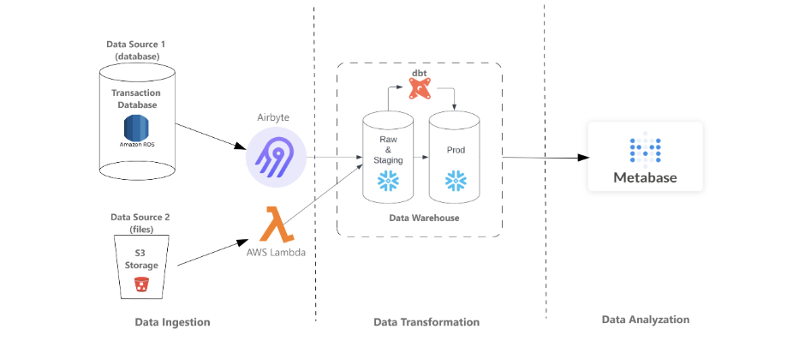

Slide 3
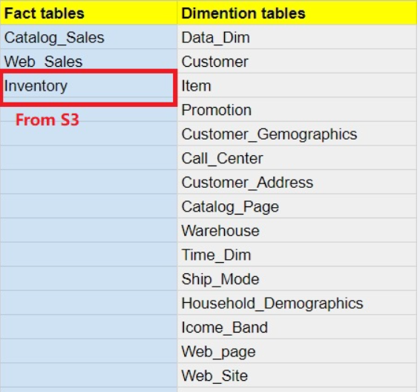
Data Source- TPCDS

Slide 4
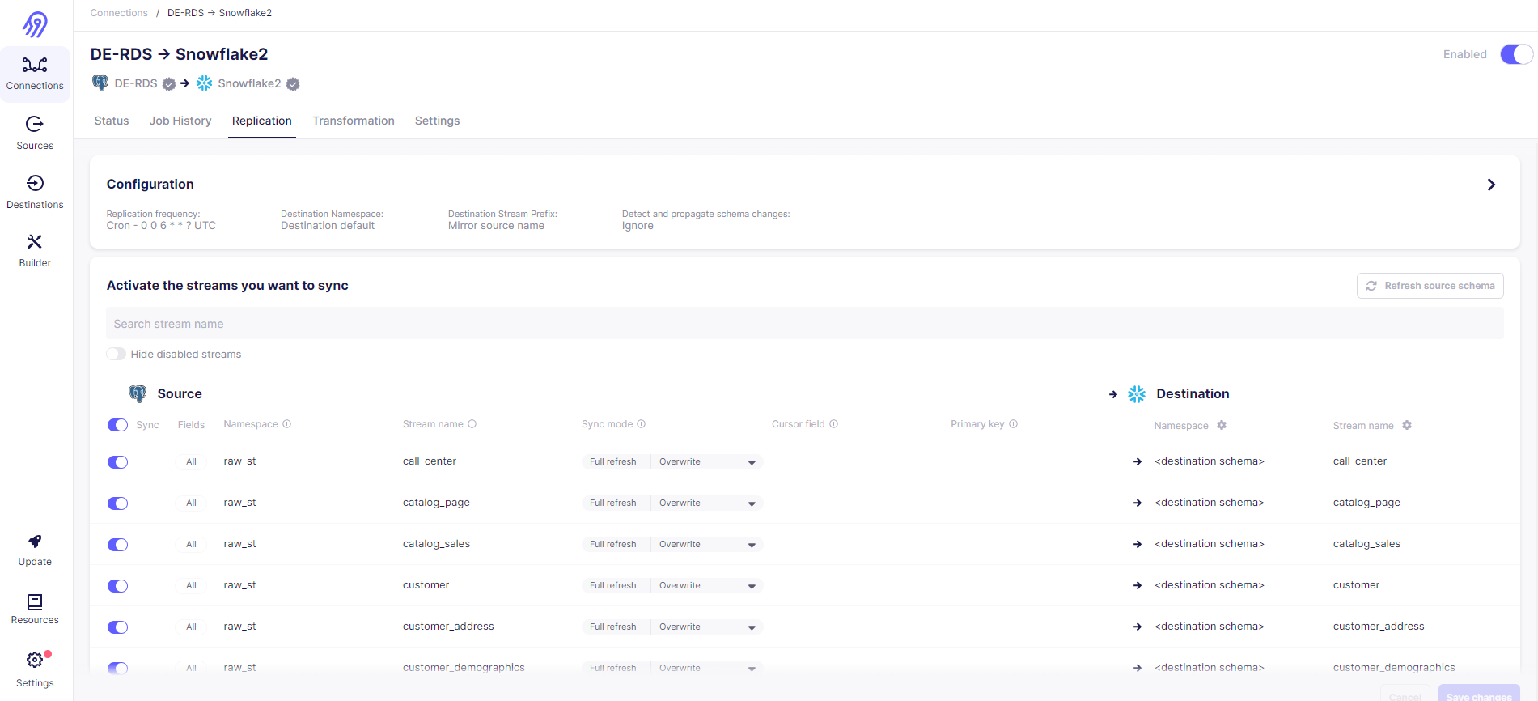
Data Ingestion - Airbyte

Slide 5
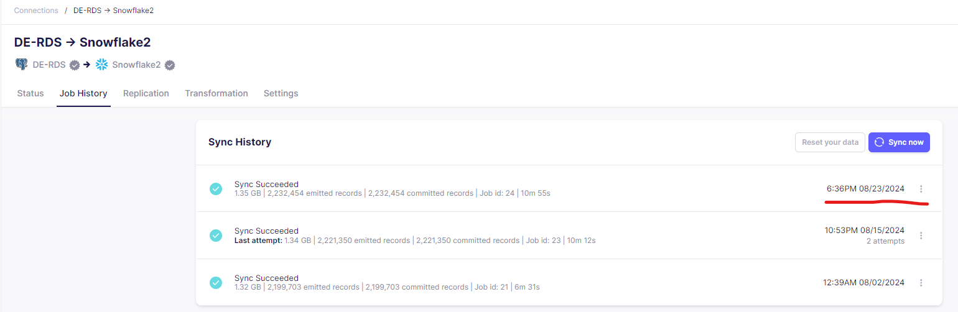
Data Ingestion - Airbyte

Slide 6
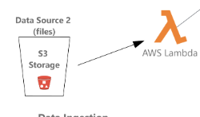
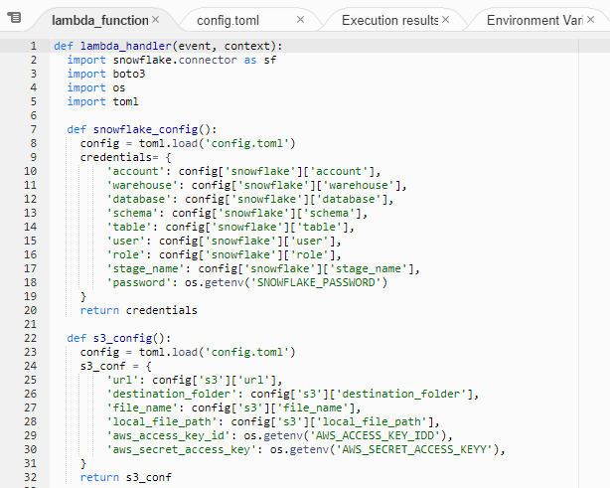
Data Ingestion – AWS Lambda

Slide 7
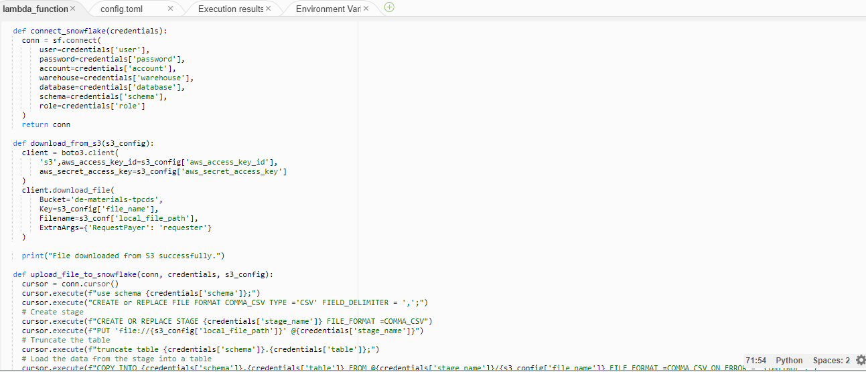
Data Ingestion – AWS Lambda

Slide 8
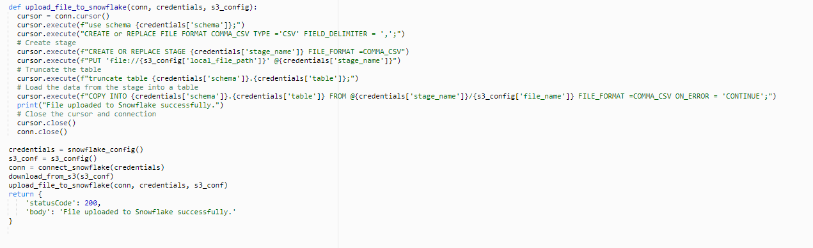
Data Ingestion – AWS Lambda

Slide 9
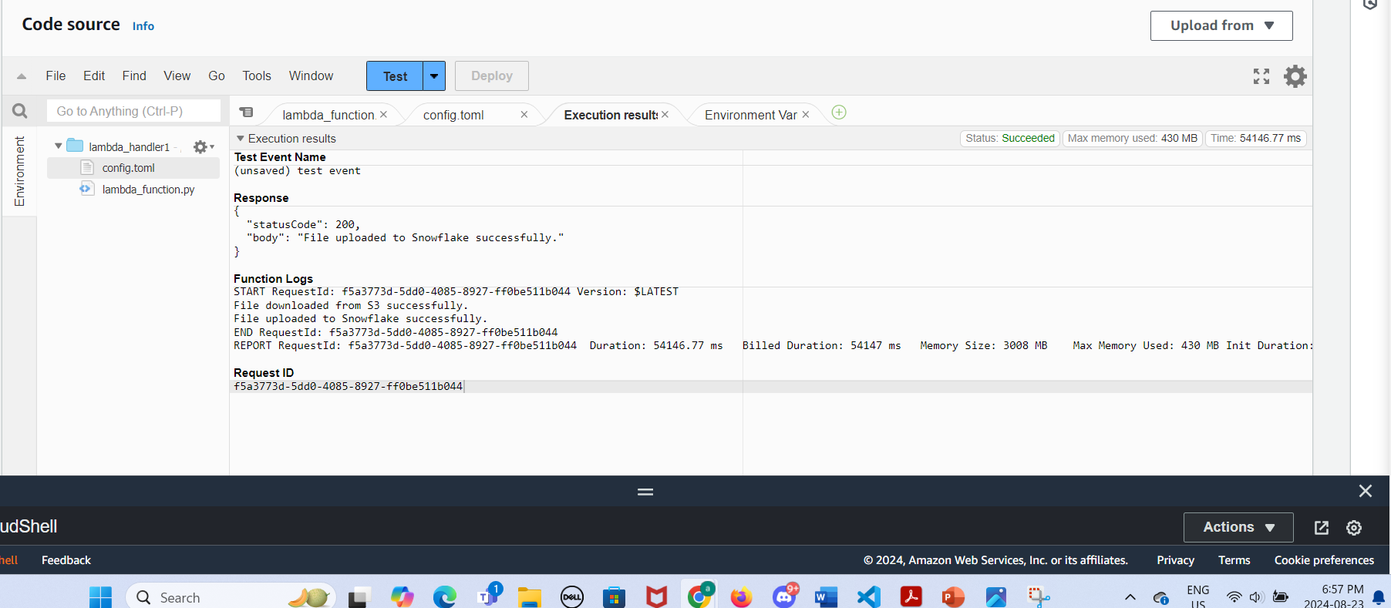
Data Ingestion – AWS Lambda

Slide 10
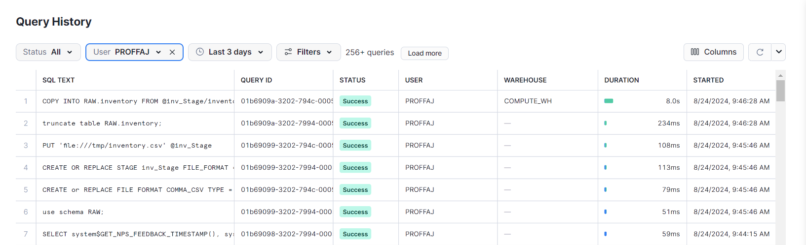
Data Ingestion – AWS Lambda

Slide 11
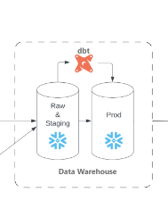
Data Transformation- DBT
- Staging
- Intermediate
-Marts

Slide 12
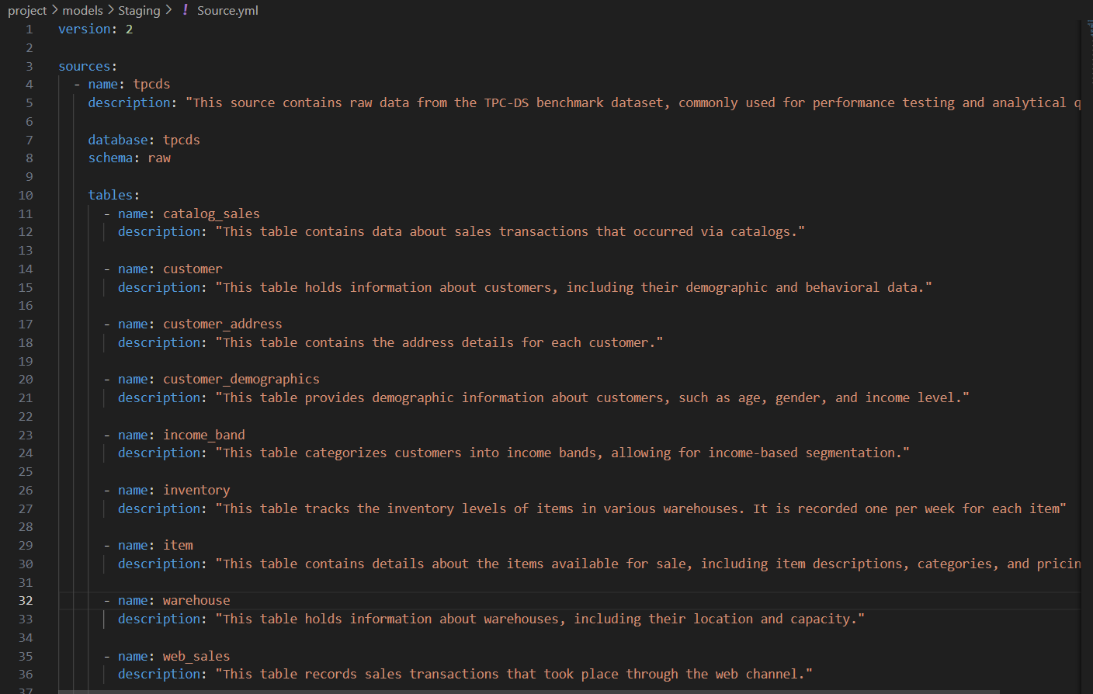
Data Transformation- DBT
Staging

Slide 13
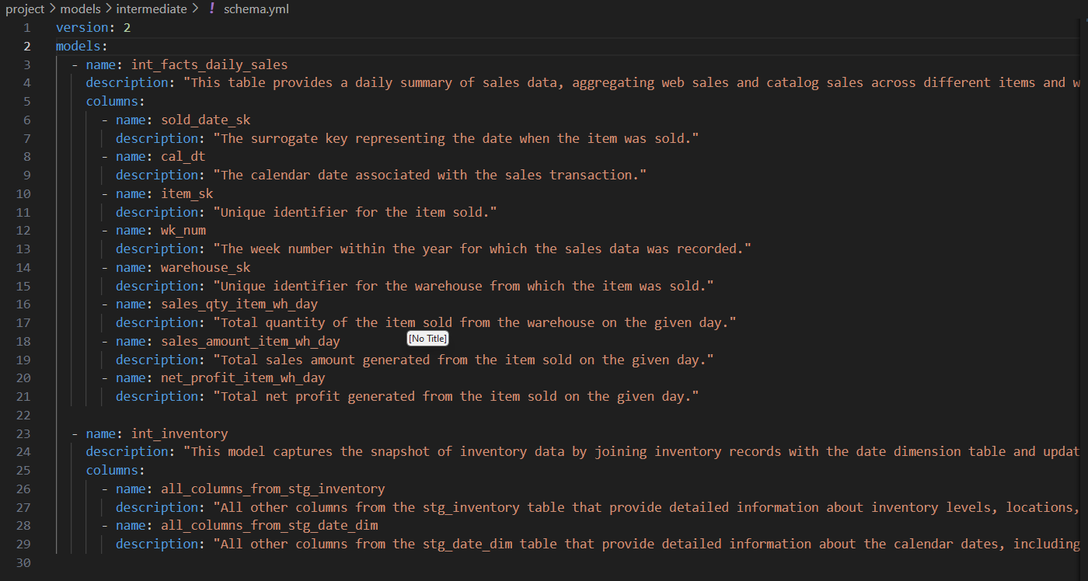
Data Transformation- DBT
Intermediate

Slide 14
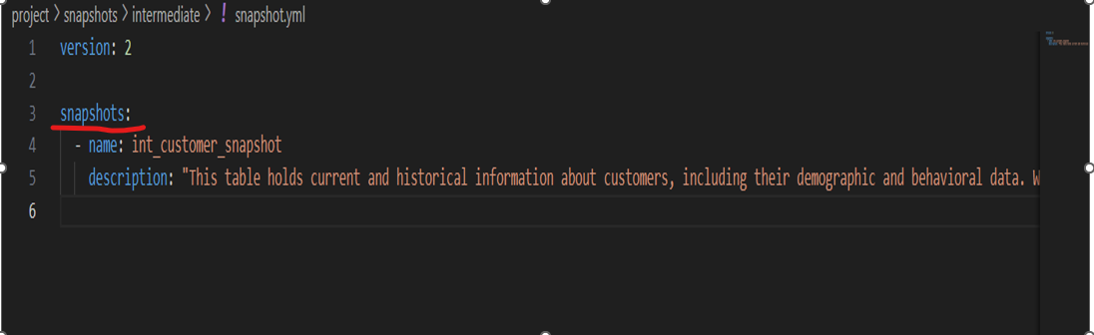
Data Transformation- DBT
Intermediate- Snapshot

Slide 15
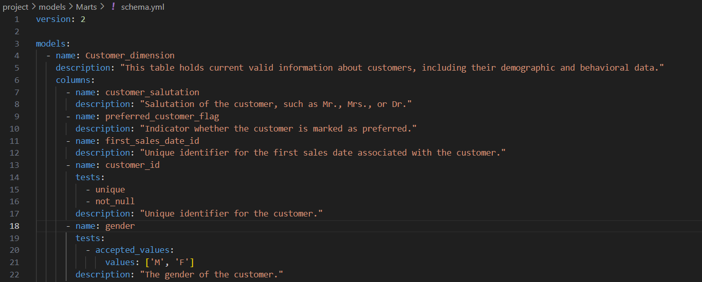
Data Transformation- DBT
Marts

Slide 16
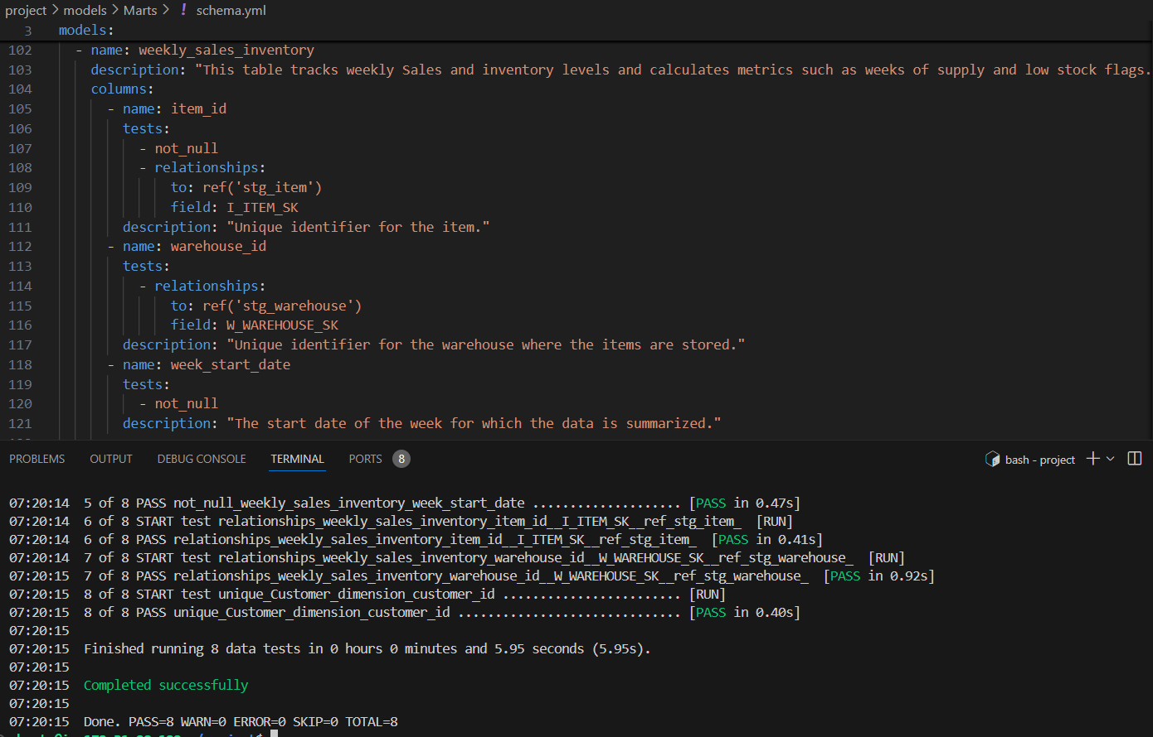
Data Transformation- DBT

Slide 17
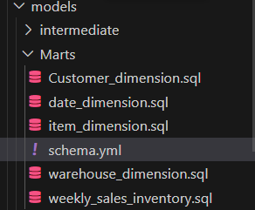
Data Transformation- DBT

Slide 18
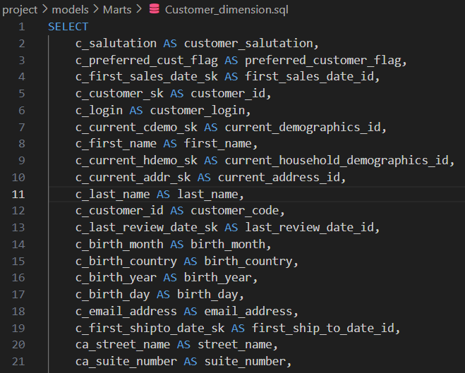
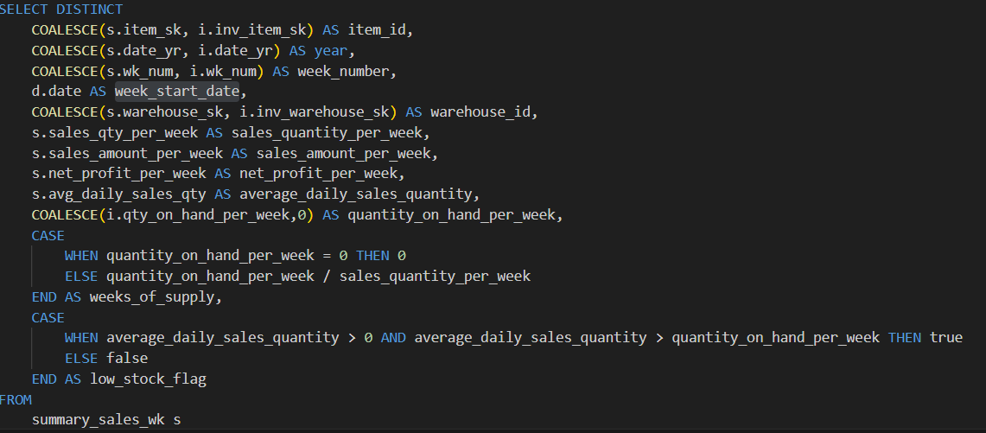
Data Transformation- DBT

Slide 19
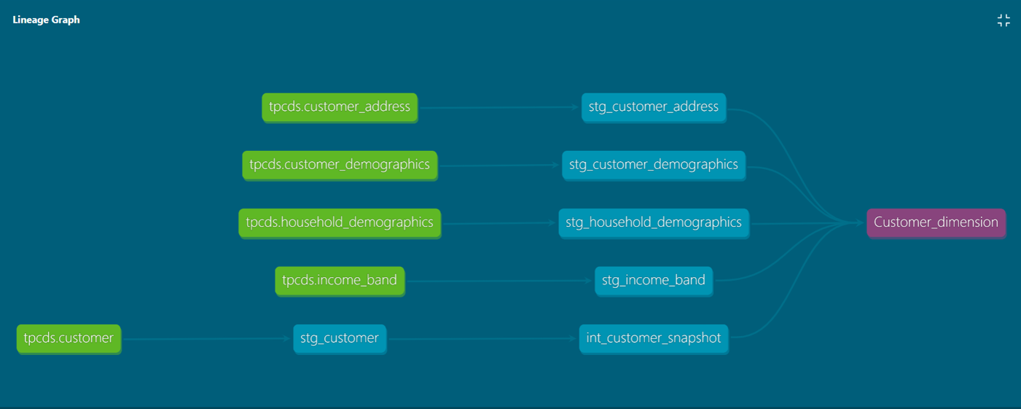
Data Transformation- DBT

Slide 20
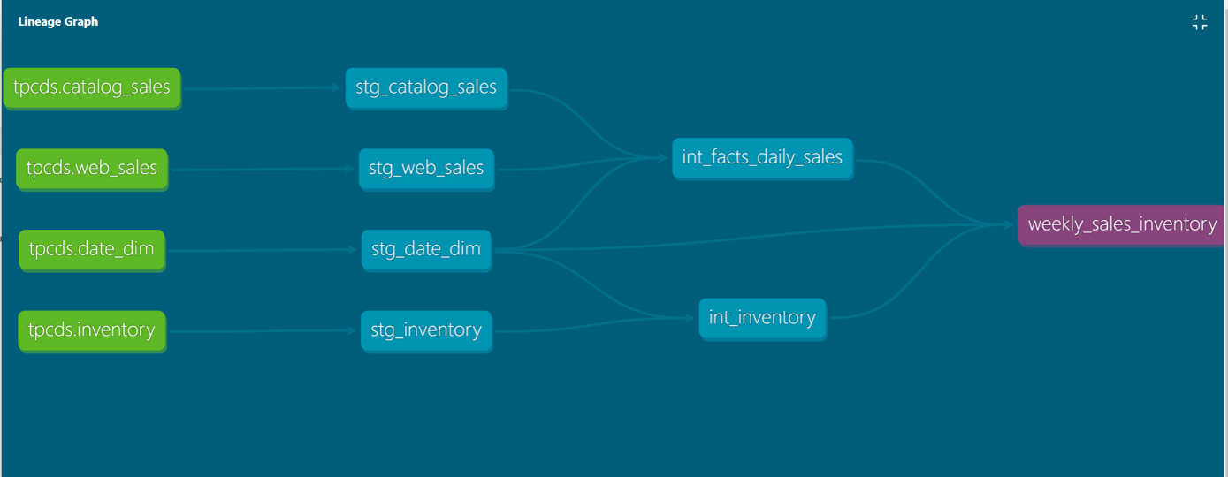
Data Transformation- DBT

Slide 21
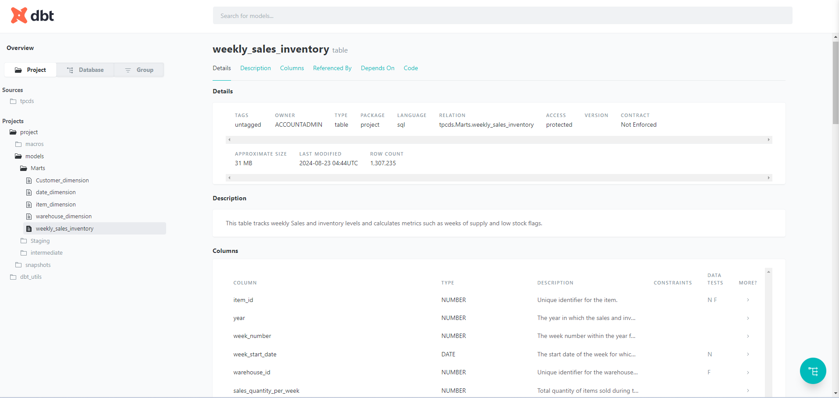
Data Transformation- DBT

Slide 22
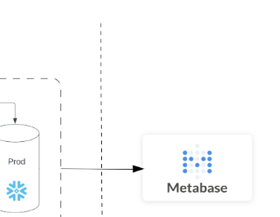
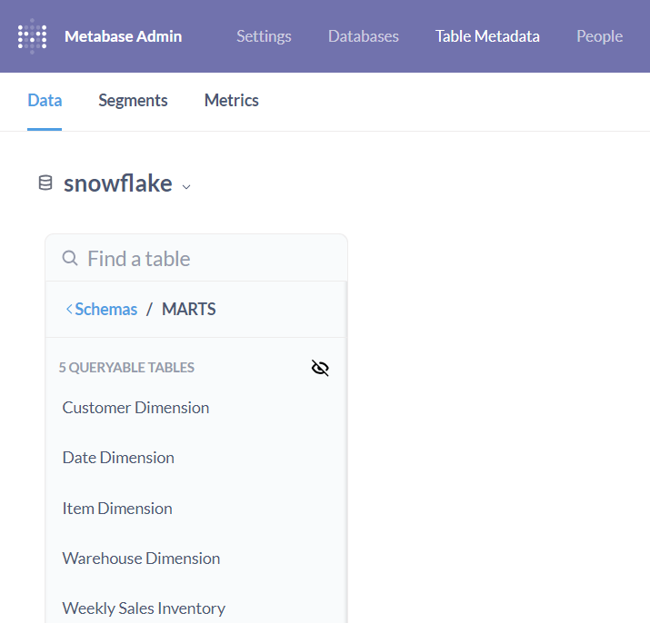
Data Analyzation -Metabase

Slide 23
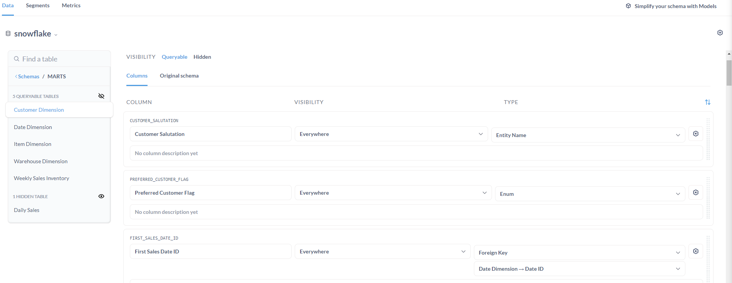
Data Analyzation -Metabase

Slide 24
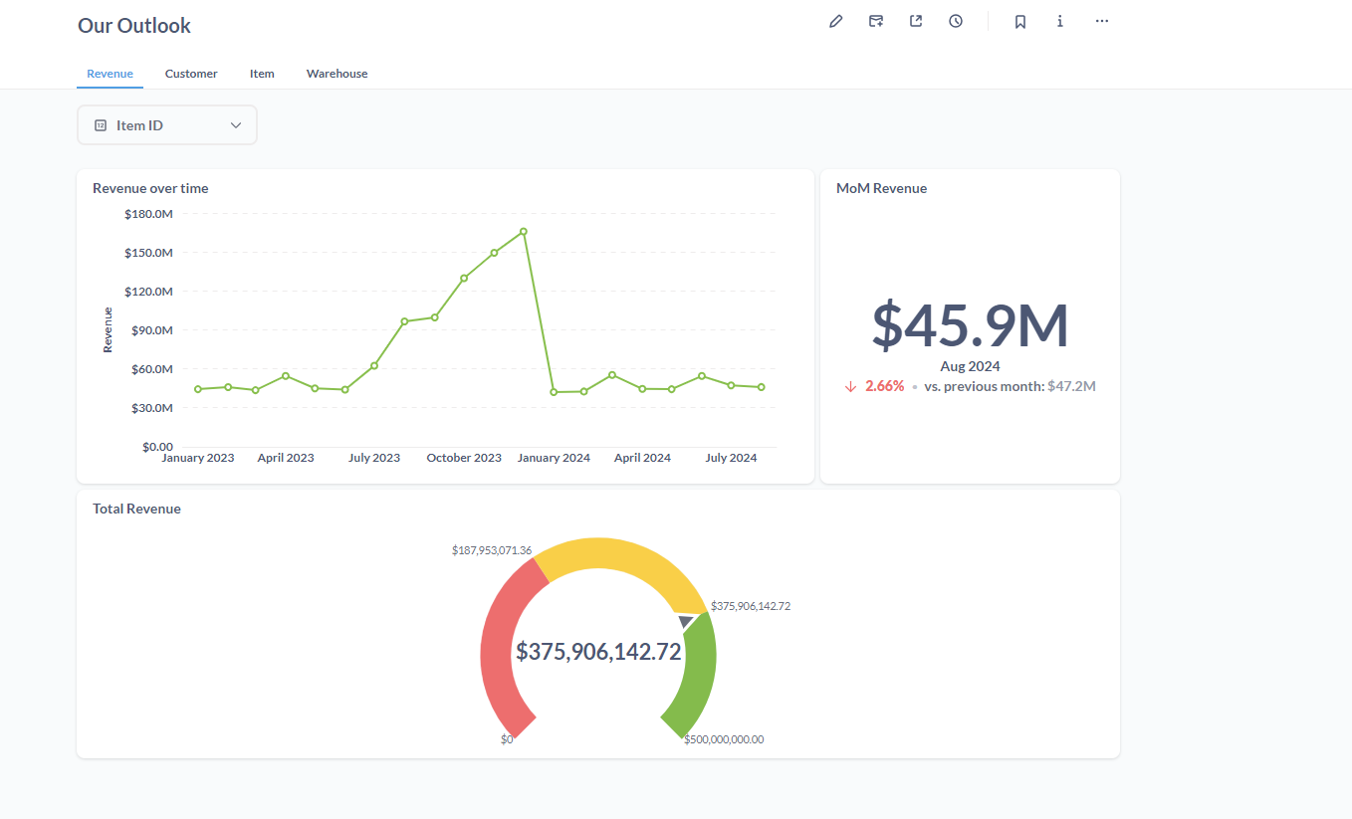
Data Analyzation -Metabase

Slide 25
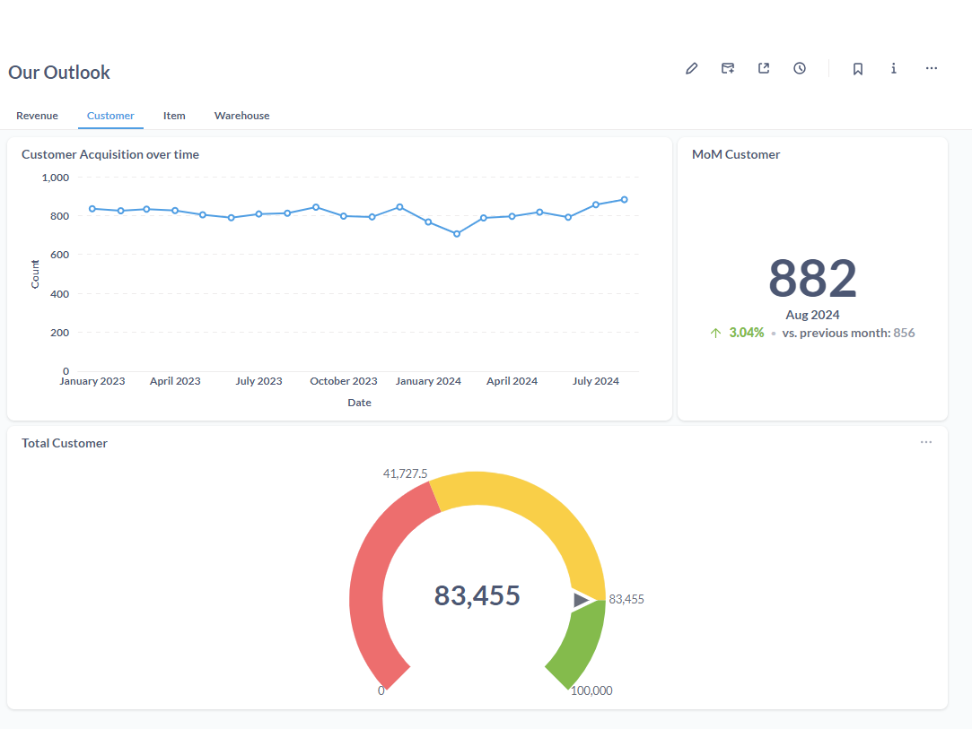
Data Analyzation -Metabase

Slide 26
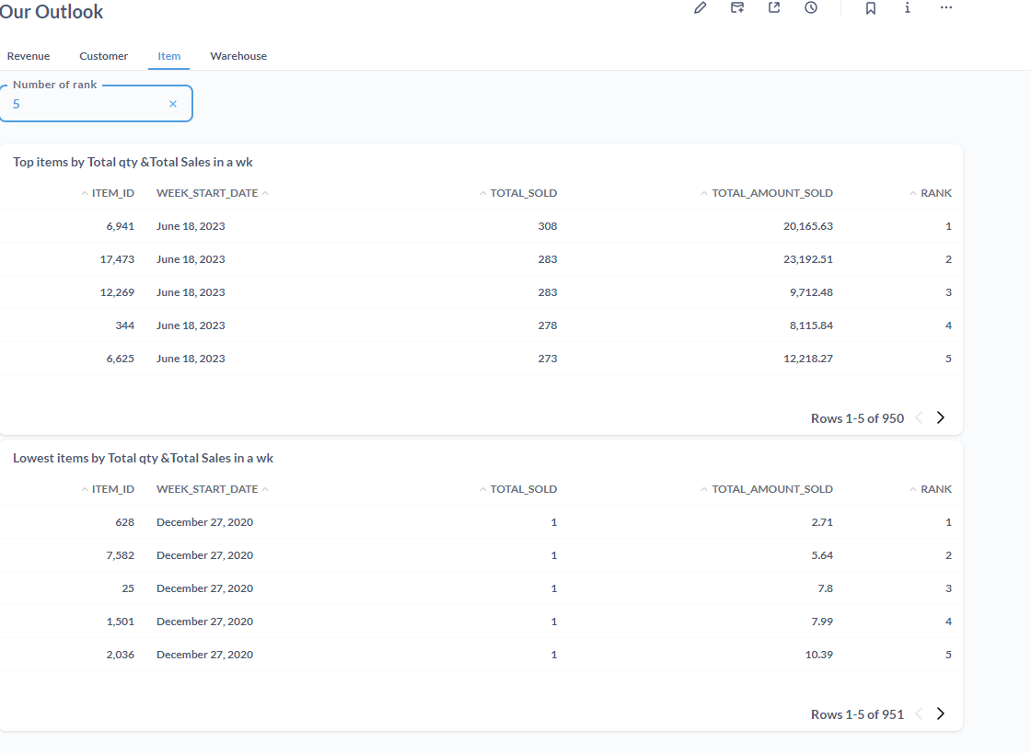
Data Analyzation -Metabase

Slide 27
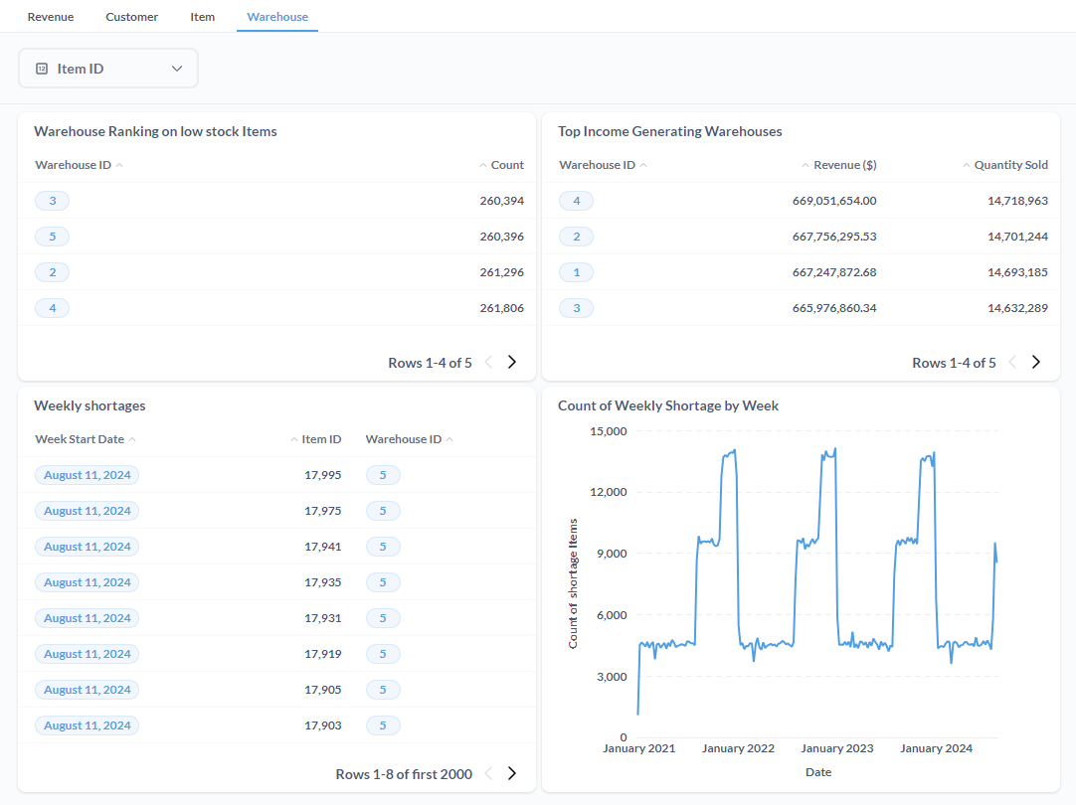
Data Analyzation -Metabase

Slide 28
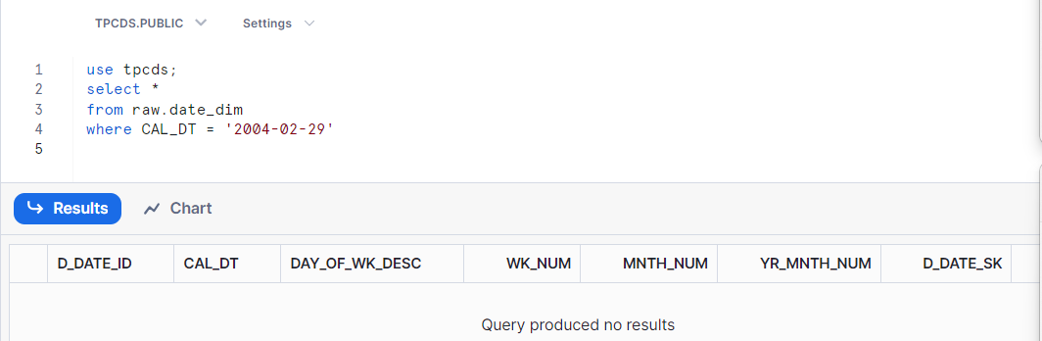
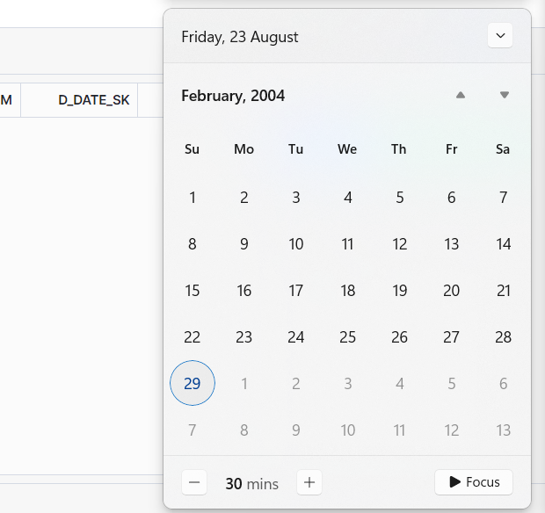
Limitations
29 Feb 2004 was not recorded in raw date_dimension table

Slide 29
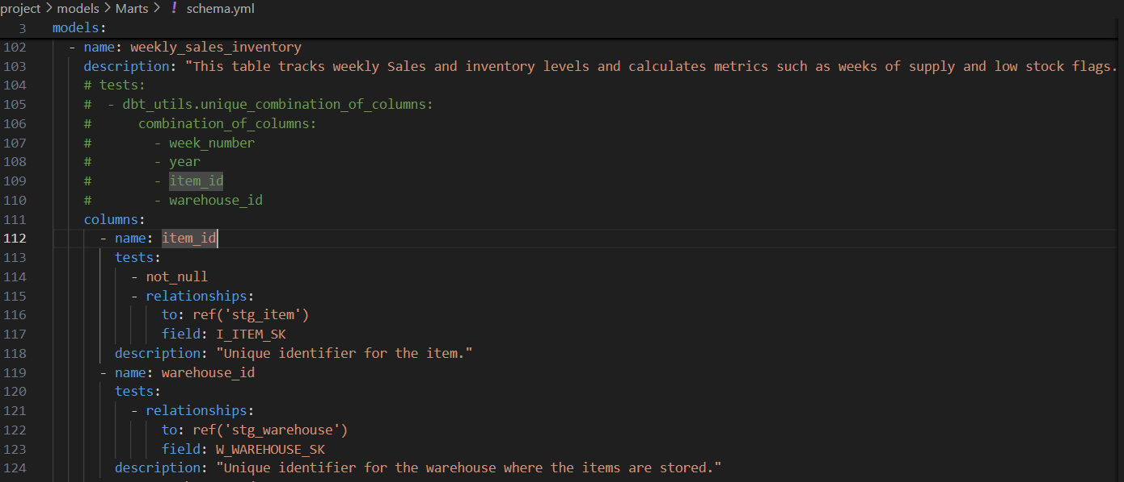
Challenges
Initially, unique combination of column test failed in dbt but passed in snowflake. This was eventually resolved

Slide 30
Challenges
Toml was missing initially in my requirements . But later Learnt we can stack up to five layers to our lambda functions
Connecting to EC2 instance with vs code on windows -SSH Private key “too open”

Slide 31
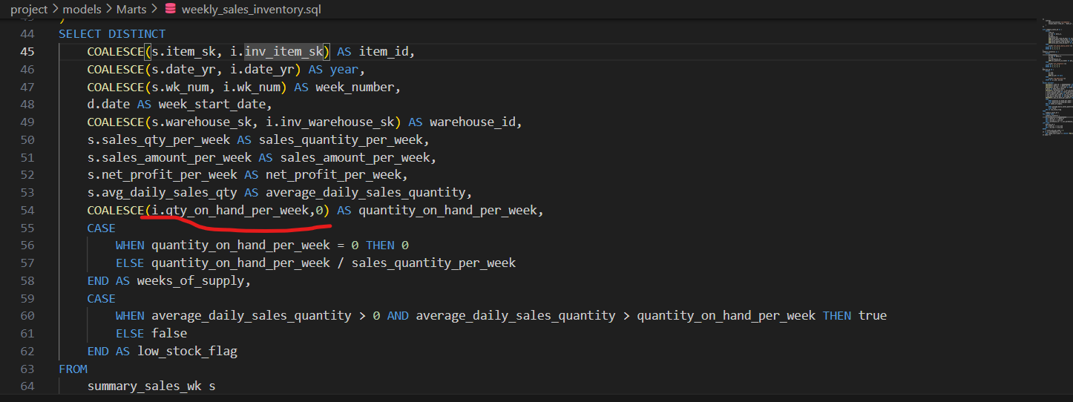
Challenges
-Initially had too many null Low Stock flag- Caused by -Inventory Quantity on hand Per Week null values – eventually turned to zero with coalesce

Slide 32
Future Work
Performance was based on Revenue, profit would be considered to see the effect of cost on the business
Filter by multiple criteria within each tab in Metabase
Use Airbyte to ingest data from s3 bucket
Will like to use macro to generate files in the staging layer
More tests

Slide 33
Thank you!

